Slide 1
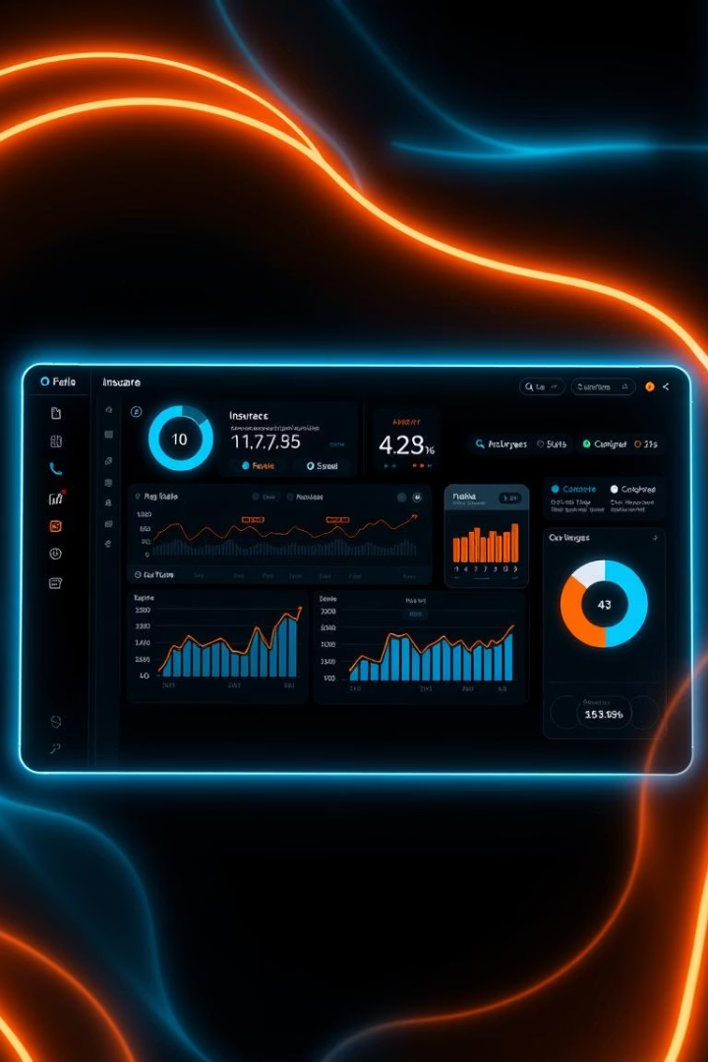

Business Ownership Policy Insurance Broker Portal
Empowering small business brokers with seamless quote management tools.
by HARSH UPADHYAY IET Student

Slide 2


Introduction to Business Ownership Policies
What is BOP?
Importance
Comprehensive small business insurance covering property, liability, and more.
Offers protection and peace of mind to small business owners.
Our Goal
Help brokers streamline quote management and boost productivity efficiently.

Slide 3
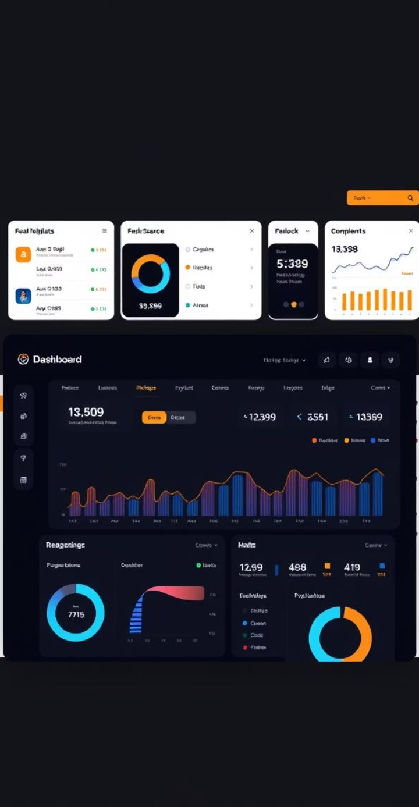
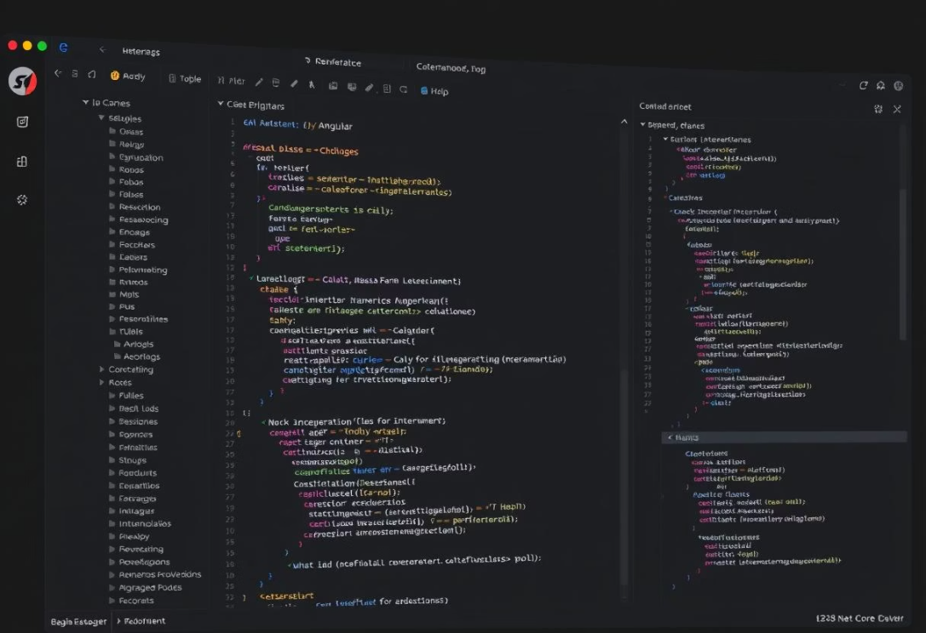
Objective and Scope of the Broker Portal
Centralized Platform
Easily generate and manage BOP quotes in one place.
Quote Simplification
Track quotes, submit forms, and view premium breakdowns effortlessly.
Technology Stack
Angular Frontend
ASP.NET Web API Backend
JWT Authentication & EmailJS
Scope
Broker-side access only; Admin panel is out of scope.

Slide 4
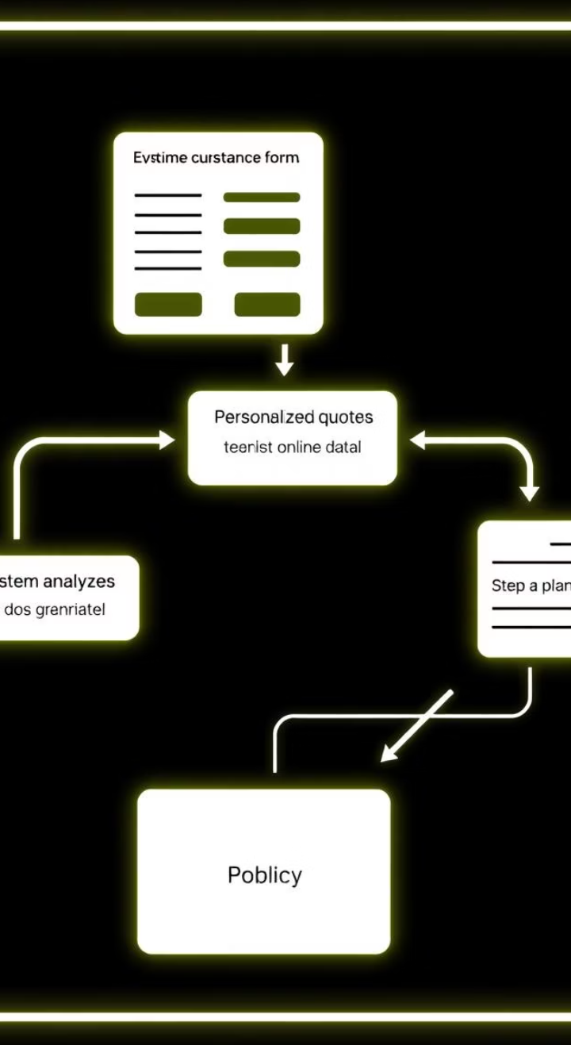



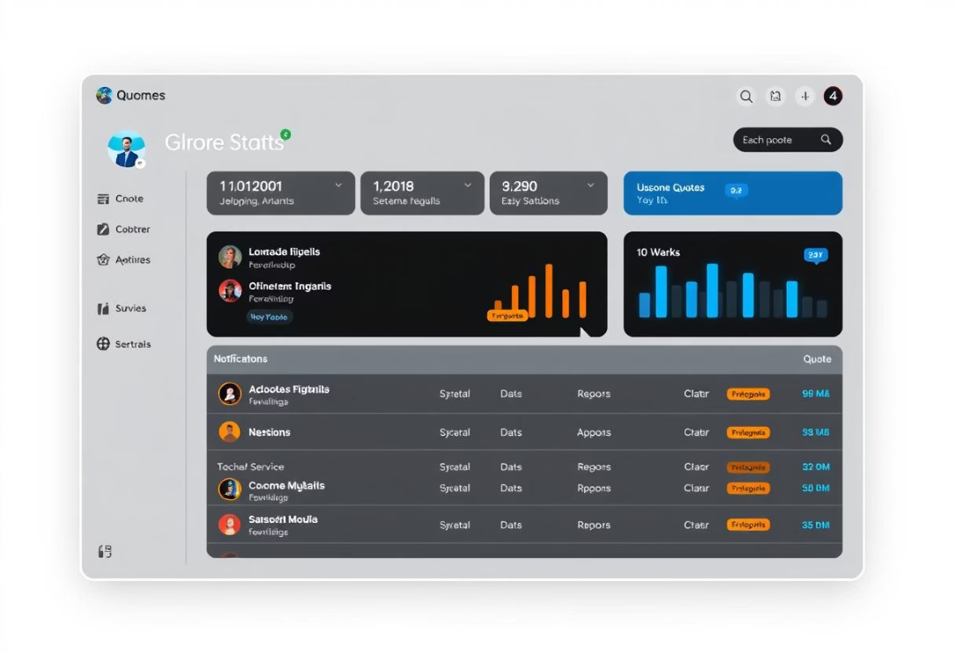
Workflow & Functional Flow
User Journey
Home → Login/Register → Dashboard
Create Quote → Fill Form → API Calculation
Quote Management
Review Terms & Conditions
Submit & Await Admin Approval
PDF Generation & Email Notification
Quote Access
View, Edit, Delete (Once)
Downloadable PDFs

Slide 5
Technical Architecture Overview
Frontend
Backend
Database & Auth
Additional Services
Angular framework for responsive and modern UI.
ASP.NET Core Web API powering business logic and data handling.
Entity Framework with SQL Server, JWT Authentication for secure access.
EmailJS for notifications, Rating API for dynamic premiums, PDF auto-fill.

Slide 6
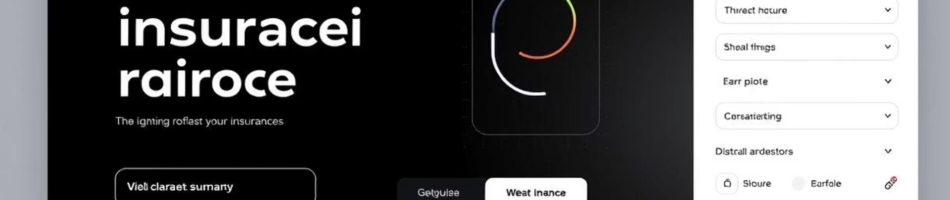




Functional & Technical Features
PDF Auto-fill
Real-time Notifications
Quote Management
Dynamic T&C Cards
Upload documents to auto-populate quote forms.
Stay updated on quote actions instantly via bell icon.
Edit and delete quotes with validations and limitations.
Display customized terms for Normal, Gold, and Premium plans.

Slide 7
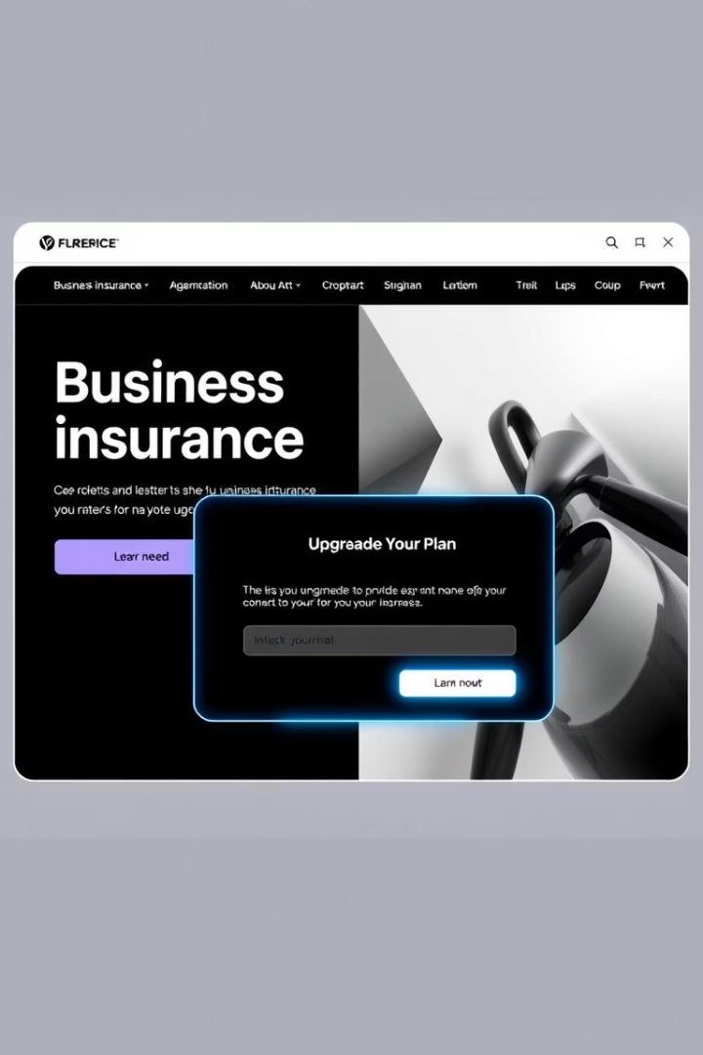
Innovations & Creative Enhancements
PDF Upload
Saves time by auto-filling quote data.
Upgrade Plan Prompts
Interactive dialog for plan upselling highlighting benefits.
Future Scope
Group chat and admin-to-broker communications planned.
Neumorphic UI
Modern cards and controls improve visual appeal and clarity.

Slide 8
Out of Scope & Project Outcomes
Out of Scope
Outcomes
Admin panel development not included
Fully functional Angular frontend connected to .NET backend
No role-based UI enhancements currently
Email sending restricted from backend
Live quote submission with dynamic premium calculations
Working PDF generation and real-time notifications via EmailJS
Secure authentication with JWT implemented

